Slide 1
Aspen Simulation: Centrifugation and Sedimentation
Team 9
Luke Hakun
Himadhri Seneviratne
Reuben Spencer
Hayden Whitley

Slide 2
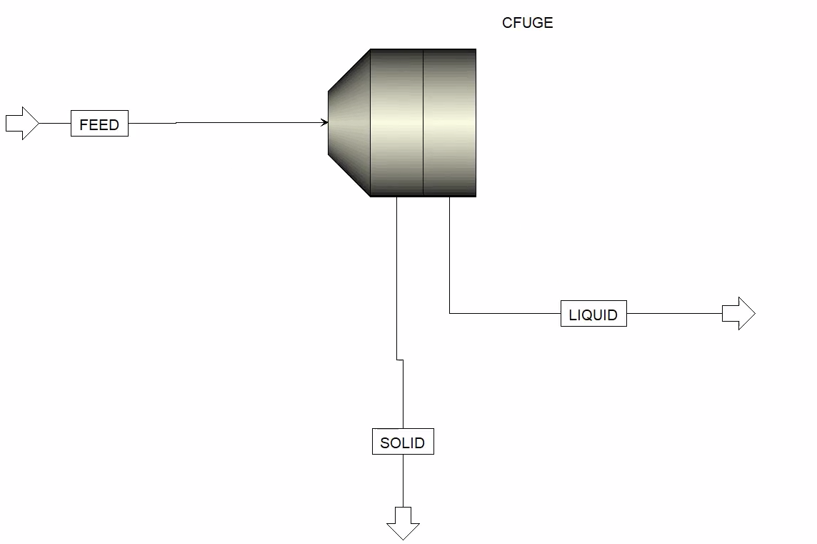
Centrifuge (CFuge)
For: Separation of Liquids from Solids
Utilizes centrifugal force
Simulates Centrifuge filter
Assumes separation of 1 (no residual solids in filtrate stream)
*DOF/ Parameters vary by chosen model
Different Models:
Solids Separator
Perforated Basket
Decanter
Disc
Pusher

Slide 3
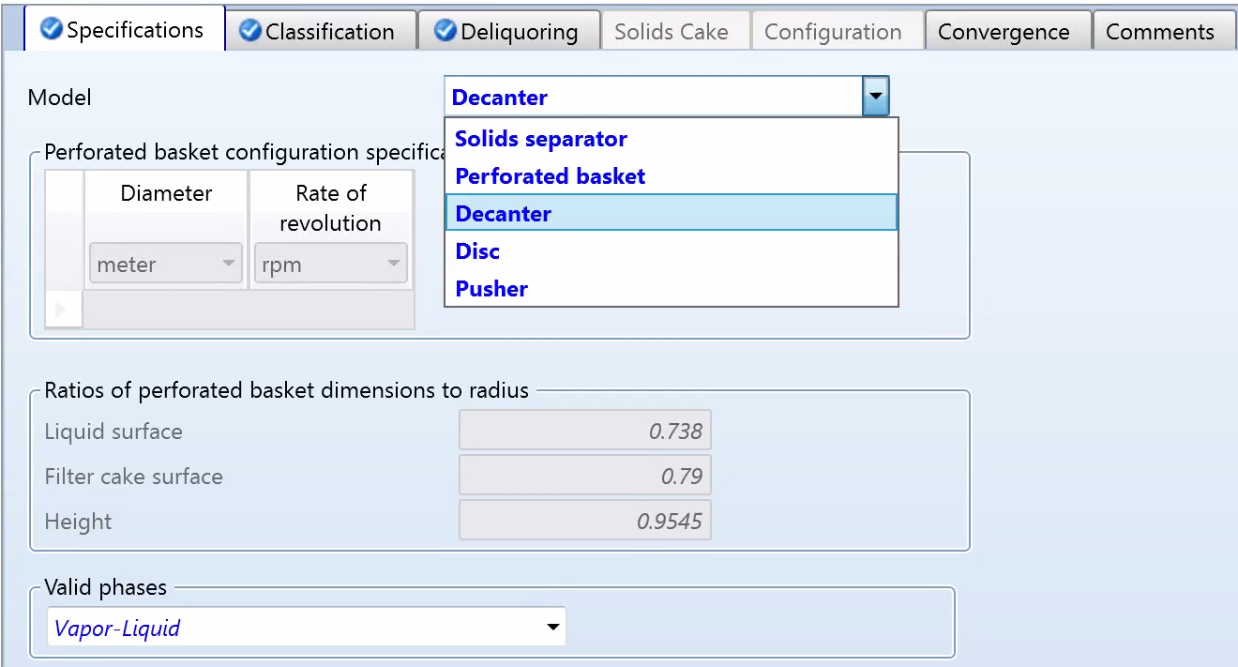
Centrifuge (CFuge) Inputs
Differences in Centrifuge Models:
Solids Separator- generic model
Needs specification for a flash
Perforated Basket- batch processing
Basket, rotation, and filter cake parameters
Decanter- continuous
Disc- continuous
Pusher- continuous
Appropriate model depends greatly on feed characteristics
Particle size, amount of solids, type of solids
Notes:
differences

Slide 4
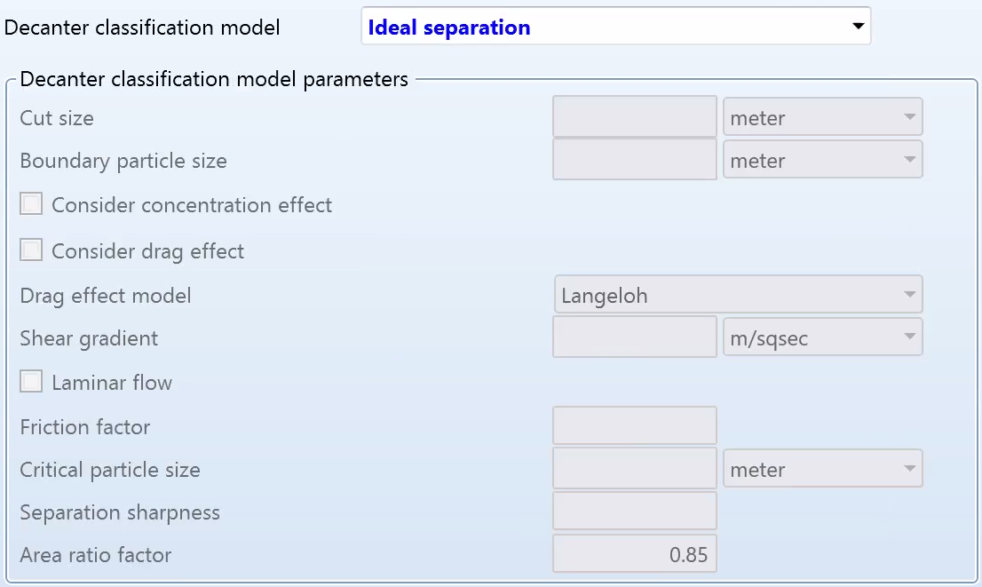
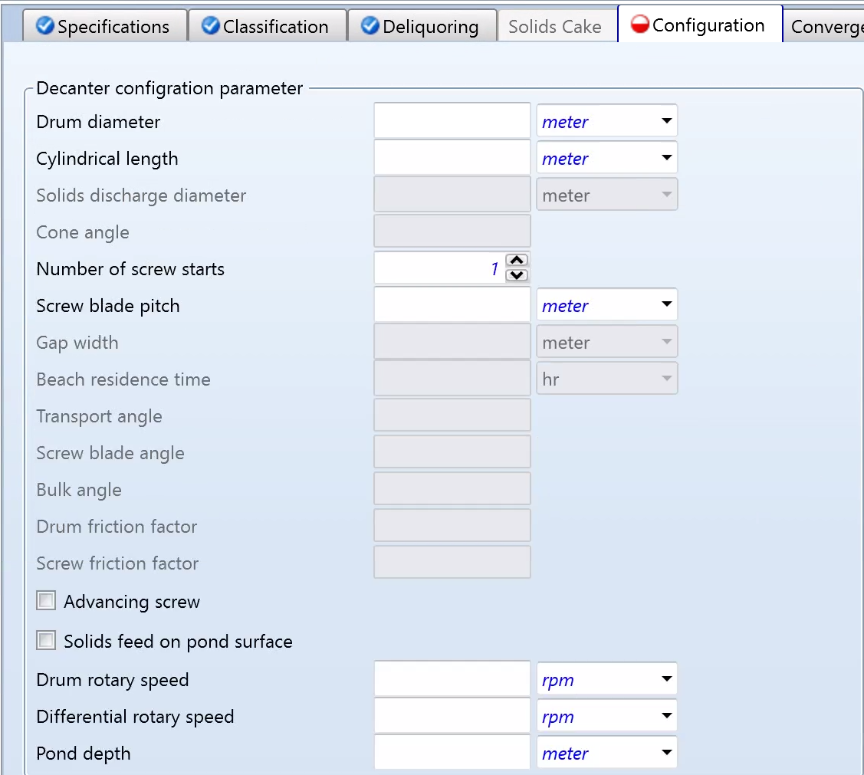
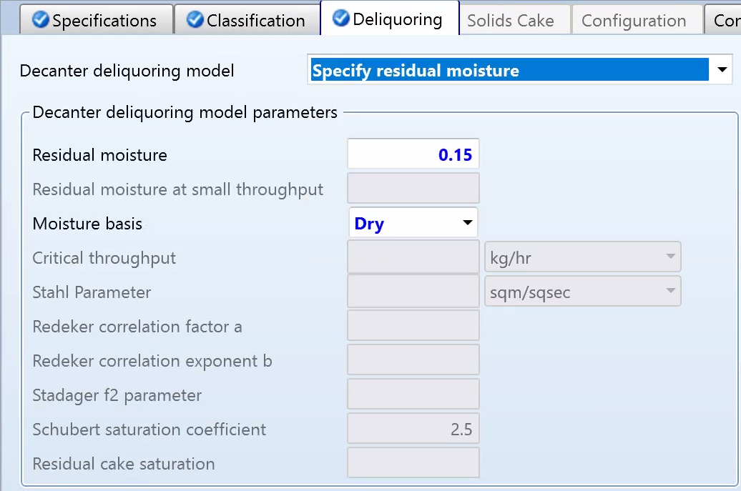
Common CFuge Inputs
Classification
Non-ideal methods factor in unit configuration, flow, other parameters
Deliquoring
Specify moisture left in solids, or need parameters for different models

Slide 5
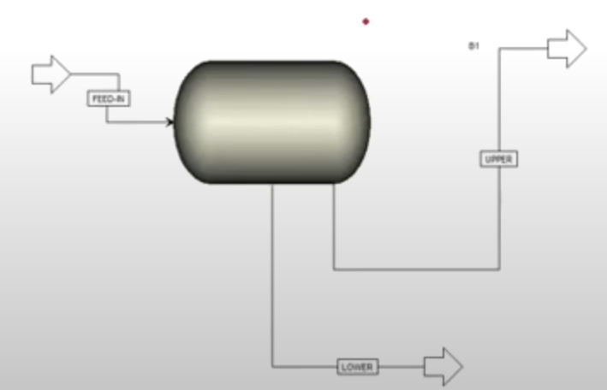
Decanter (Centrifuge)
For: Liquid-liquid separation by separating two liquid phases of different densities
Utilizes centrifugal force
Feed stream must be liquid
Use Flash3 if vapor phase present in feed
Outputs are high-density and low-density streams
*Decanter Centrifuge for separating solid from
liquid
DOF: 2 - Pressure and Temperature or Duty

Slide 6
Decanter - method
Sample problem statement
A stream coming out of lle has a molar flow rate of 100 kmol/hr. This stream comprises a mixture of decane and water, with molar fractions of 0.4 and 0.6, respectively. The water is at 25 degrees Celsius and 1 bar, while the decane is at 1 bar and 35 degrees Celsius.
What can we find using the decanter simulation in Aspen?
Molar flow rates of bottom and side streams
YouTube. (2021, October 25). Aspen plus | decanter simulation in aspen plus. YouTube. https://www.youtube.com/watch?v=_6McptkGzlw

Slide 7
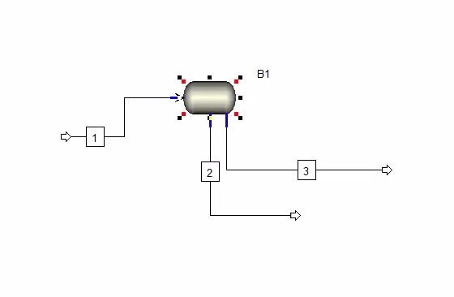
Decanter - Results
Set up : Results :

Slide 8
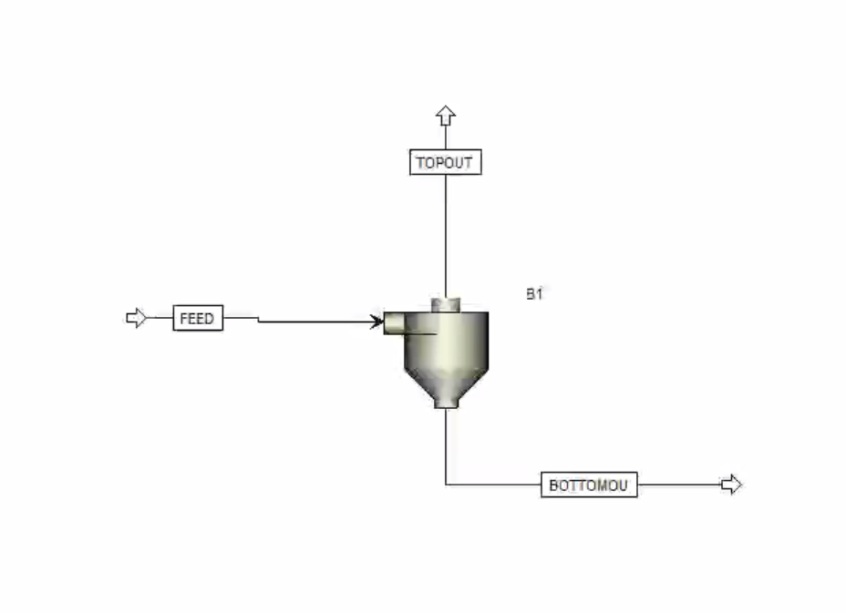
Cyclone
For: Separate solid particles from gas or liquid stream
Utilizes centrifugal force of a gas vortex
Separates based on particle size distribution (density)
Outputs are solid (bottom) and gas (top) streams
Feed Stream: Must input particle size distribution (Std. Dev. & Mean)
Parameters:
Model: Cyclone
Calculation Method
Type
Diameter
Number of Cyclones

Slide 9
Cyclone Methods and Setup
Kaolinite(Al2Si2O5(OH)4) and Air mixture
Ideal Method used
Kaolinite is a solid clay silicate mineral
Particle sizes with an average of 8 microns and a standard deviation of 5
30C and 5 Bar
YouTube. (2020, September 5). Aspen Plus, solids, cyclone, particle size distribution. YouTube. https://www.youtube.com/watch?v=aLBE3JFsJwM

Slide 10
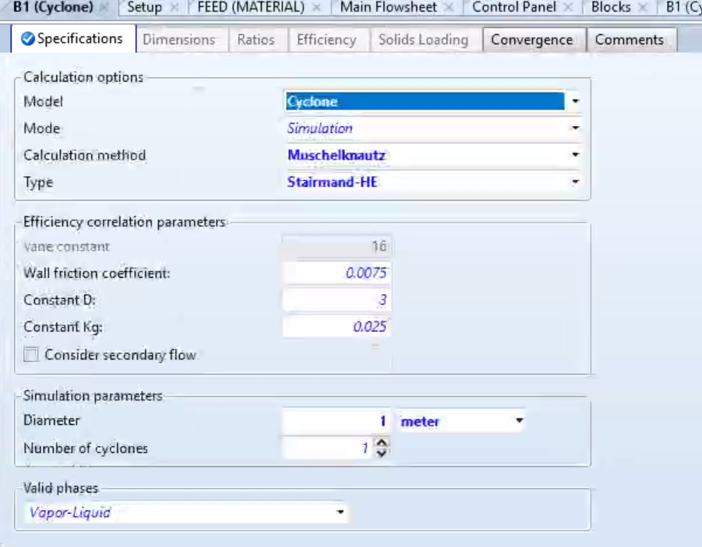
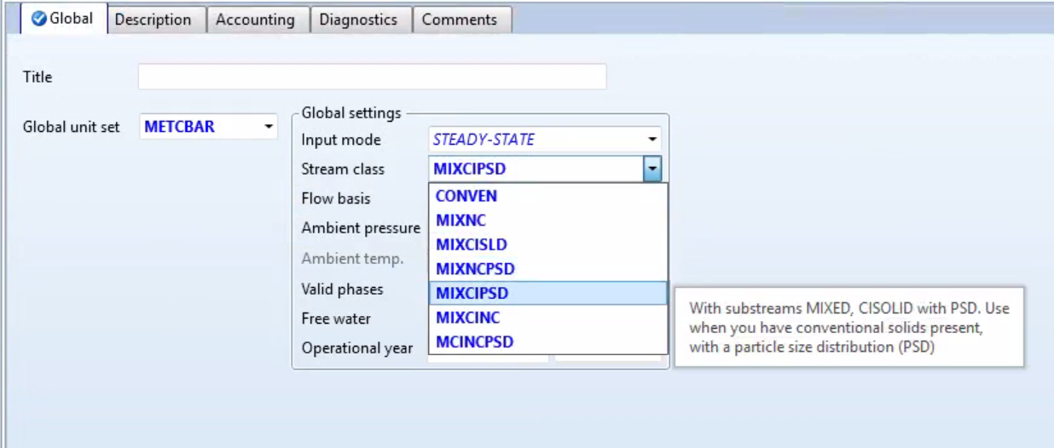
Block and Solid Specifications
Standard calculation method of Muschelknautz with a high efficiency type.
Diameter of 1 meter
Consider the Kaolinite particles to be conventional solids with a particle size distribution
Notes:
We used a high efficiency model and particles are considered to be conventional and have a particle size distribution.

Slide 11
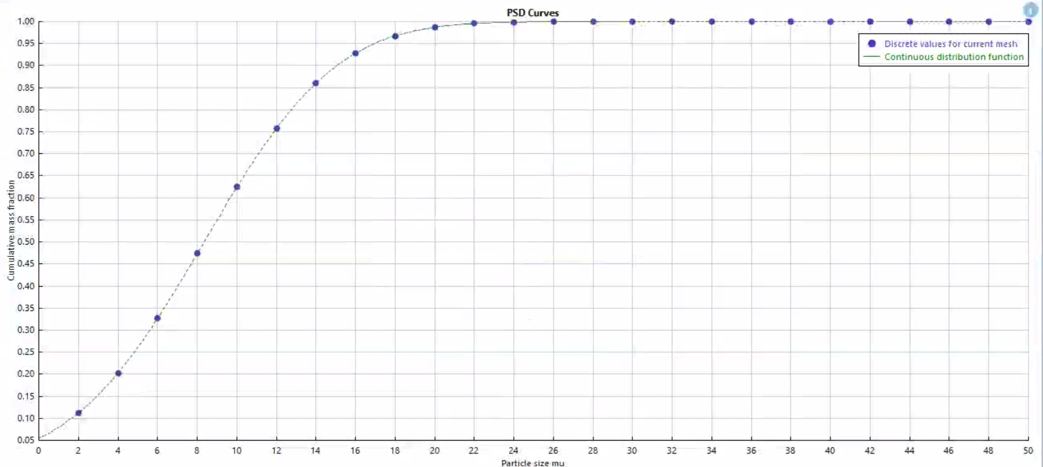
Particle Size Distribution Chart in Feed

Slide 12
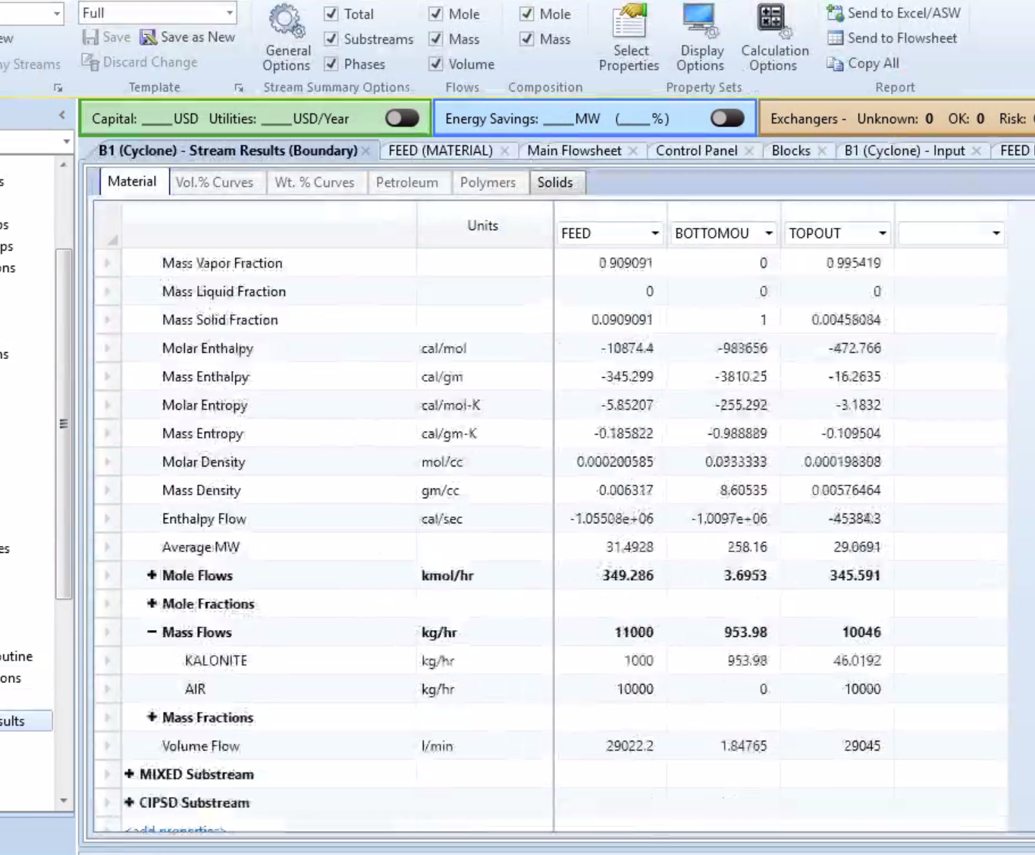
Aspen results of Cyclone
Kaolinite went from 1000 kg of solid in feed stream to 46.02 kg in top stream and 953.98 kg in bottom stream
95.4% recovery of Kaolinite from airstream (mass)

Slide 13
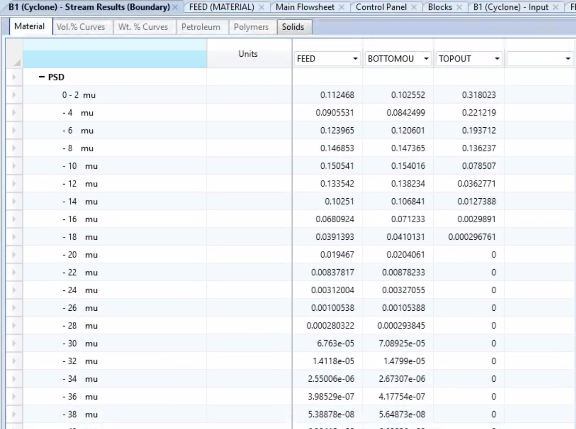
PSD results of Cyclone
Particle size distribution from feed to top and bottom of cyclone
Larger particles are not as prevalent in top and particles (20> mu) not present in top
Smaller particles still present in top, but this is to be expected

Slide 14
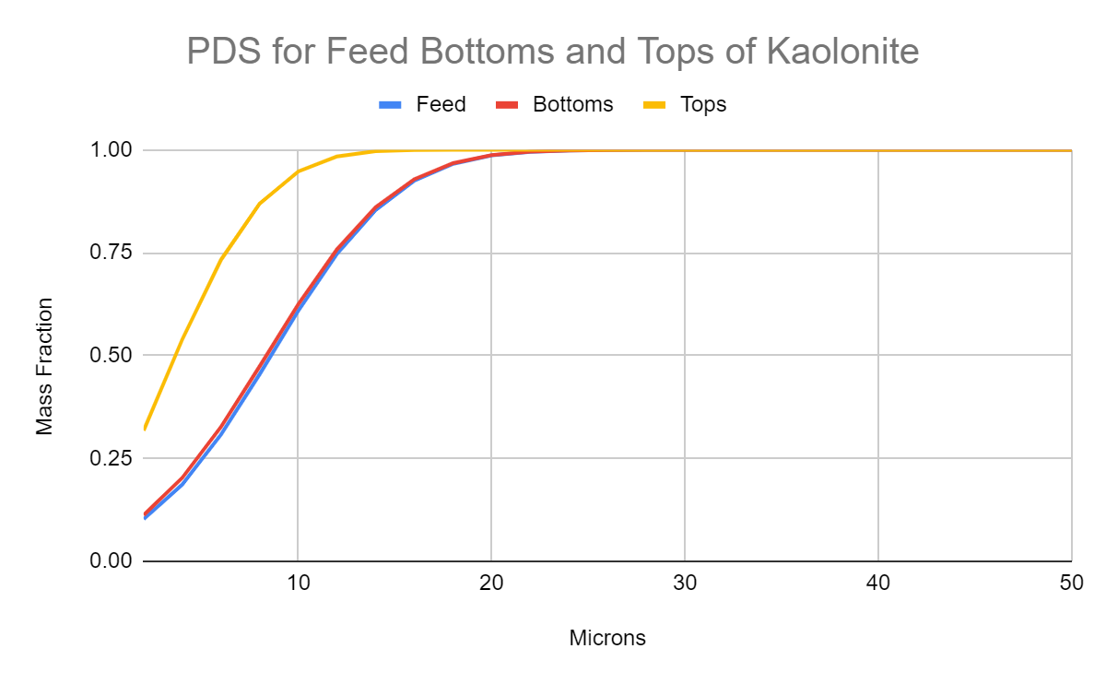
PDS Results Cont

Slide 15
Ways to improve efficiency of Separation in Aspen
Optimizing operating conditions ( temperature, pressure, flow rates)
Column design and configuration ( separation columns, tray conf., packing type, reflux ratios)
Running sensitivity analysis.

Slide 16
Questions?

